Slide 1
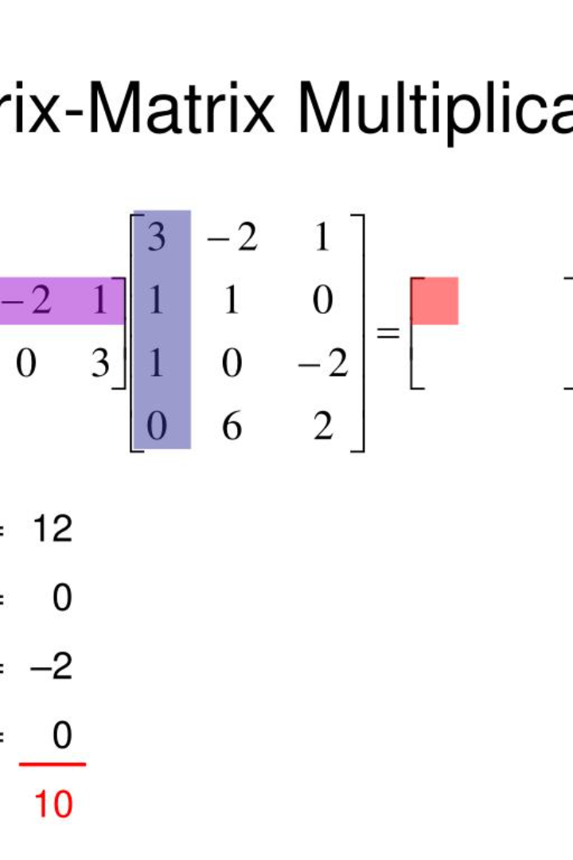
8085 Matrix Multiplication
Welcome! In this presentation, we'll take an in-depth look at how the 8085 microprocessor can be used to perform matrix multiplication. Come along for an engaging and enlightening journey!

Slide 2
Introduction
What is Matrix Multiplication?
Why use 8085?
Matrix multiplication is a mathematical operation that combines two matrices to produce a third matrix. It is a fundamental operation in linear algebra and has applications in various fields of science and engineering.
The 8085 is a popular microprocessor with a wide range of applications. It is an excellent choice for this task due to its simplicity and versatility.

Slide 3
Explanation of 8085 Matrix Multiplication
1
Step 1:
Load the first matrix into memory location 8000-8F0H and the second matrix into memory location 9000-98FH.
Step 2:
2
Initialize the counter registers B, C, and D.
3
Step 3:
Load the address of the first element of the first matrix into the HL register pair.
Step 4:
4
Load the address of the first element of the second matrix into the DE register pair.
5
Step 5:
Multiply the corresponding elements of the matrices using a loop and store the results in the third matrix at location A000-A8FH.

Slide 4

Program Code
; Initialize data and memory
LXI B, 4200H ; Load B with the memory address of the first matrix
LXI D, 4300H ; Load D with the memory address of the second matrix
CALL MUL ; Call the subroutine MUL
STA 4500H ; Store the sum in 4500H
INX B
LXI D, 4302H
CALL MUL
STA 4501H
LXI B, 4200H
LXI D, 4301H
CALL MUL
STA 4502H
INX B
LXI D, 4303H
CALL MUL
STA 4503H
LXI B, 4202H
LXI D, 4300H
CALL MUL
STA 4504H
INX B
LXI D, 4302H
CALL MUL
STA 4505H

Slide 5
LXI B, 4202H
LXI D, 4301H
CALL MUL
STA 4506H
INX B
LXI D, 4303H
CALL MUL
STA 4507H
CALL ADD
HLT
; The MUL subroutine
MUL: LDAX B ; Load A with the element from the first matrix (B points to the first matrix)
MOV C, A ; Copy the value to C
INX D ; Move to the corresponding element in the second matrix (D points to the second matrix)
LDAX D ; Load A with the element from the second matrix
XCHG ; Exchange the values in A and C
MVI H, 02H ; Initialize H as the loop counter
MULLOOP: ADD C ; Add the value in C to A (A += C)
DCR H ; Decrement H (loop counter)
JNZ MULLOOP ; Repeat the multiplication loop until H becomes zero
RET

Slide 6
; The ADD subroutine for summing the elements of the result matrix
ADD: LXI H, 4500H ; Load HL with the memory address of the result matrix
MOV A, M ; Load A with the value at 4500H
INX H ; Move to the next element
ADD M ; Add the value at the next memory location to A
STA 4600H ; Store the sum in 4600H
INX H
MOV A, M ; Load A with the value at the next memory location
INX H
ADD M
STA 4601H ; Store the sum in 4601H
INX H
MOV A, M
INX H
ADD M
STA 4602H ; Store the sum in 4602H
INX H
MOV A, M
INX H
ADD M
STA 4603H ; Store the sum in 4603H
RET

Slide 7
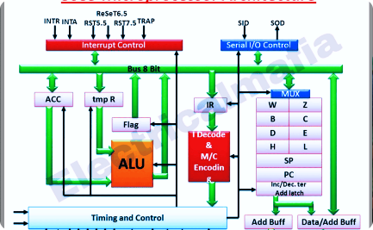
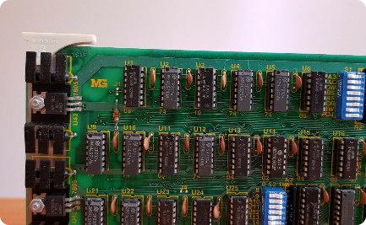

Step-by-step Execution of the Code
Step 1
Step 2
Step 3
Load the matrices into memory.
Initialize the counter registers B, C, and D.
Load the address of the first element of the first matrix into the HL register pair.

Slide 8
Timeline for Completing the Project
1
Review 1:
Research and planning.
2
Review 2:
Algorithm program and timeline.
3
Review 3:
Integration and testing.

Slide 9
Conclusion and Future Scope
Conclusion
Future Scope
8085 matrix multiplication is a complex task that can be performed efficiently. In this presentation, we have explored the fundamentals, algorithm code, and execution.
This project can be extended to perform more complex matrix operations and can be further optimized for better performance.

